Slide 1
Robot Framework
Presented By :Atul Singh

Slide 2
Agenda
Introduction
Why Robot Framework?
High-level architecture
High-level architecture
How Robot Framework works?
Support for different libraries
External library Support
Editor Support
Variables
Keyword driven approach
Framework Design

Slide 3
Introduction
Robot Framework is a Python-based, extensible keyword-driven automation framework for acceptance testing.
It supports acceptance test driven development (ATDD), behavior driven development (BDD) and robotic process automation (RPA).
It can be used in distributed, heterogeneous environments, where automation requires using different technologies and interfaces.
The framework has a rich ecosystem around it consisting of various generic libraries and tools that are developed as separate projects.
For more information about Robot Framework and the ecosystem, see http://robotframework.org.

Slide 4
Why Robot Framework?
Robot Framework is probably one of the most worthwhile test automation frameworks available in the market. In terms of value for money, it’s on the top of the list.
Here are few feature which makes Robot Framework irresistible.
Enables easy-to-use tabular syntax for creating test cases in a uniform way.
Provides ability to create reusable higher-level keywords from the existing keywords.
Provides easy-to-read result reports and logs in HTML format.
Is platform and application independent.
Provides a simple library API for creating customized test libraries which can be implemented natively with either Python or Java.

Slide 5
Why Robot Framework?
Provides a command line interface and XML based output files for integration into existing build infrastructure (continuous integration systems).
Provides support for Selenium for web testing, Java GUI testing, running processes, Telnet, SSH, and so on.
Supports creating data-driven test cases.
Has built-in support for variables, practical particularly for testing in different environments.
Provides tagging to categorize and select test cases to be executed.
Enables easy integration with source control: test suites are just files and directories that can be versioned with the production code.
Provides test-case and test-suite -level setup and teardown.
The modular architecture supports creating tests even for applications with several diverse interfaces.

Slide 6
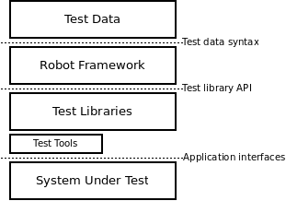
High-level architecture
Robot Framework is a generic, application and technology independent framework. It has a highly modular architecture illustrated in the diagram below.

Slide 7
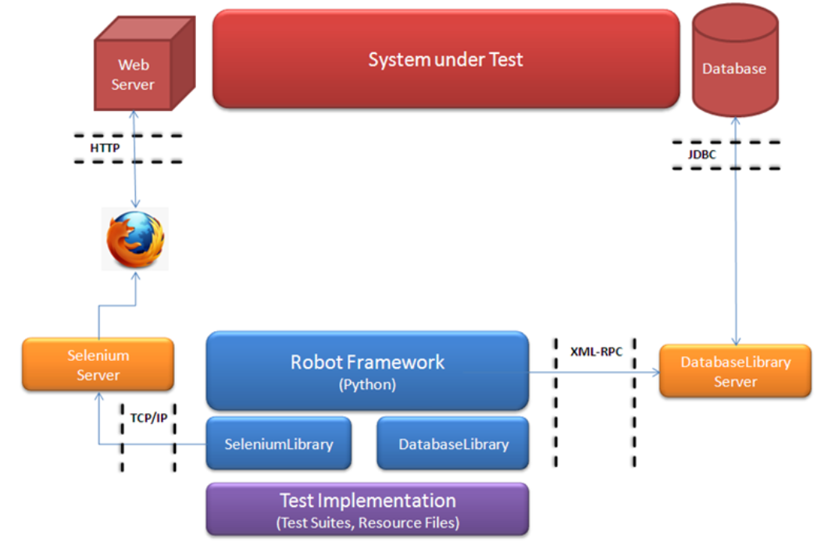
How Robot Framework works?

Slide 8
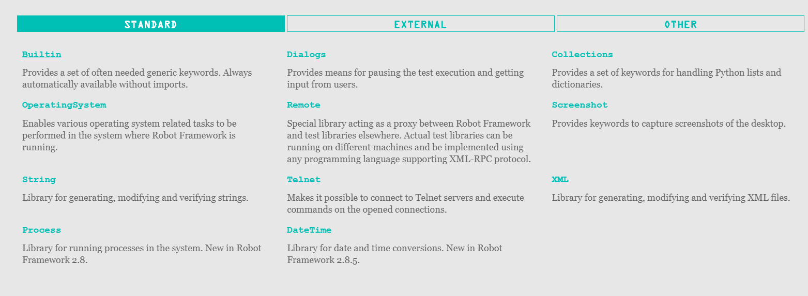
Support for different libraries
https://robotframework.org/#/libraries

Slide 9
External library Support
Appium
MongoDB
Restinstance
Selenium Library
AutoIt
Mainframe
SAPGui
Eclipse
Database Library(Java)-> using Jython
iOS library
MQTT library
Kafka
Django
HTTP library (Requests)
DataDriver Library
Sikuli Library

Slide 10
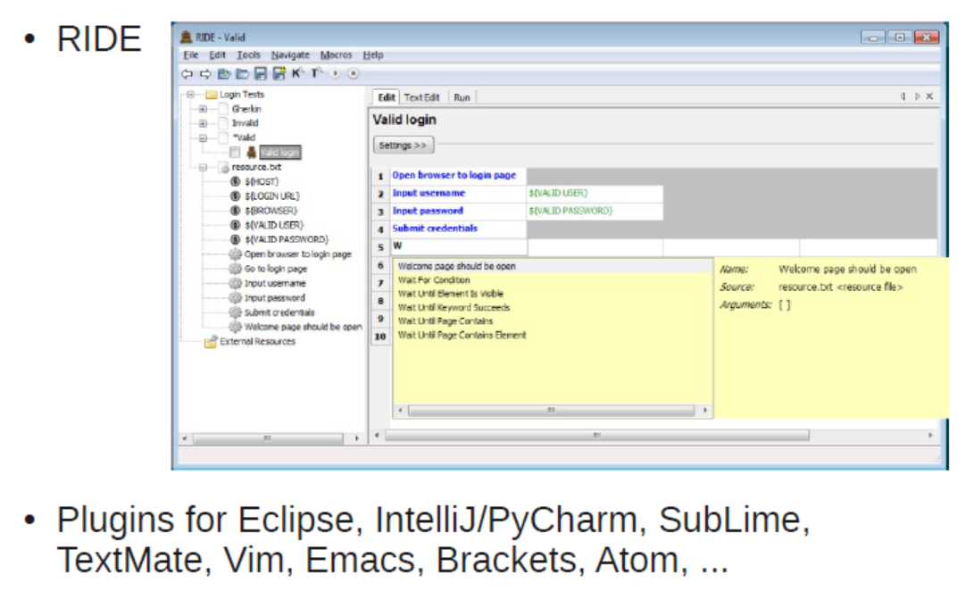
Editor Support

Slide 11
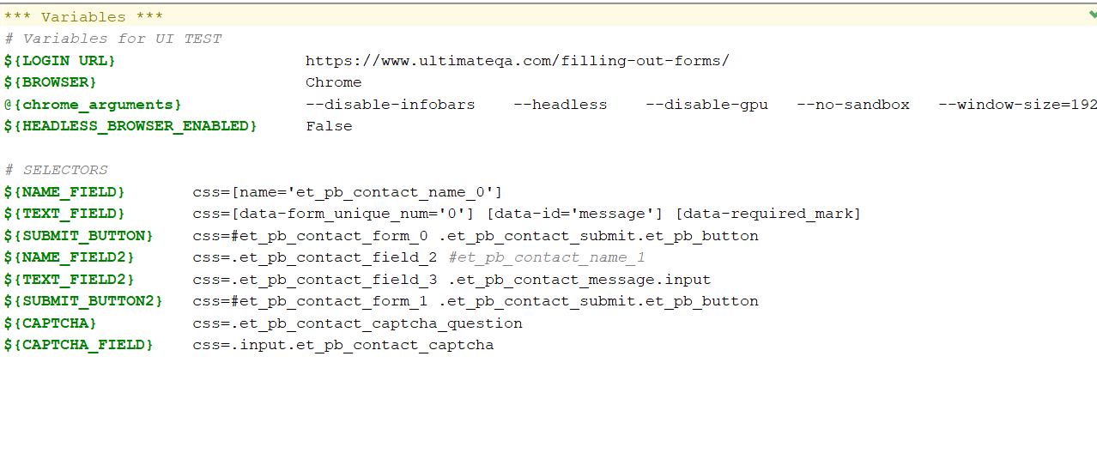
Variables

Slide 12
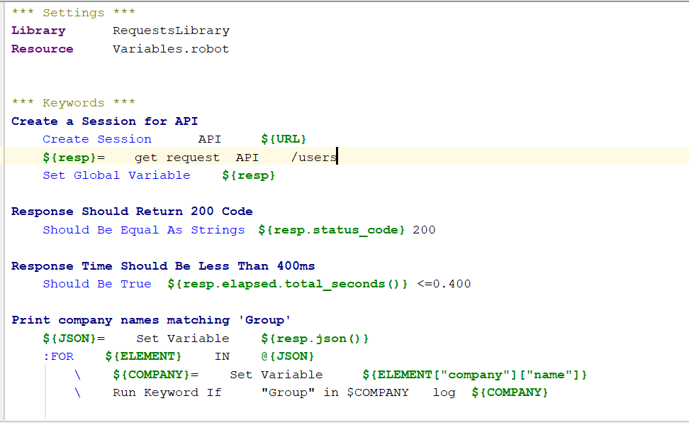
Keyword driven approach

Slide 13
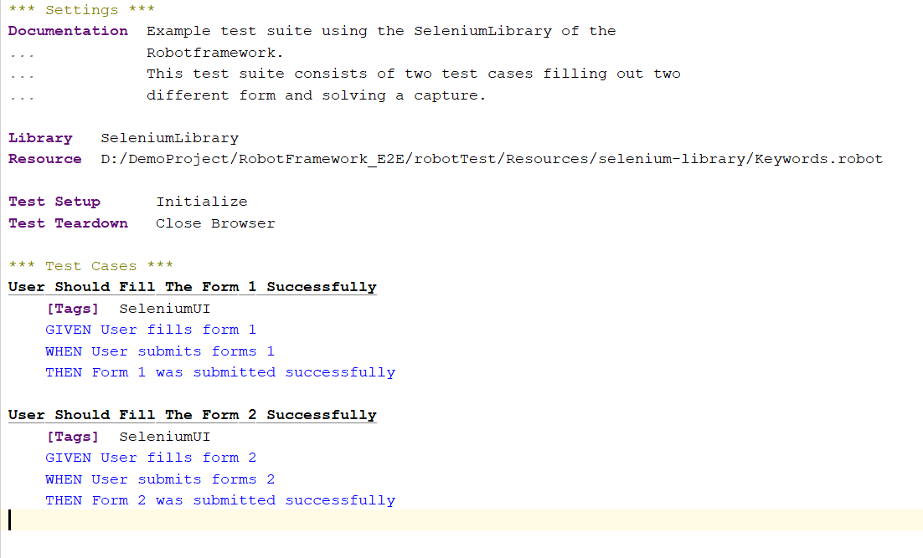
Test Case Preview

Slide 14
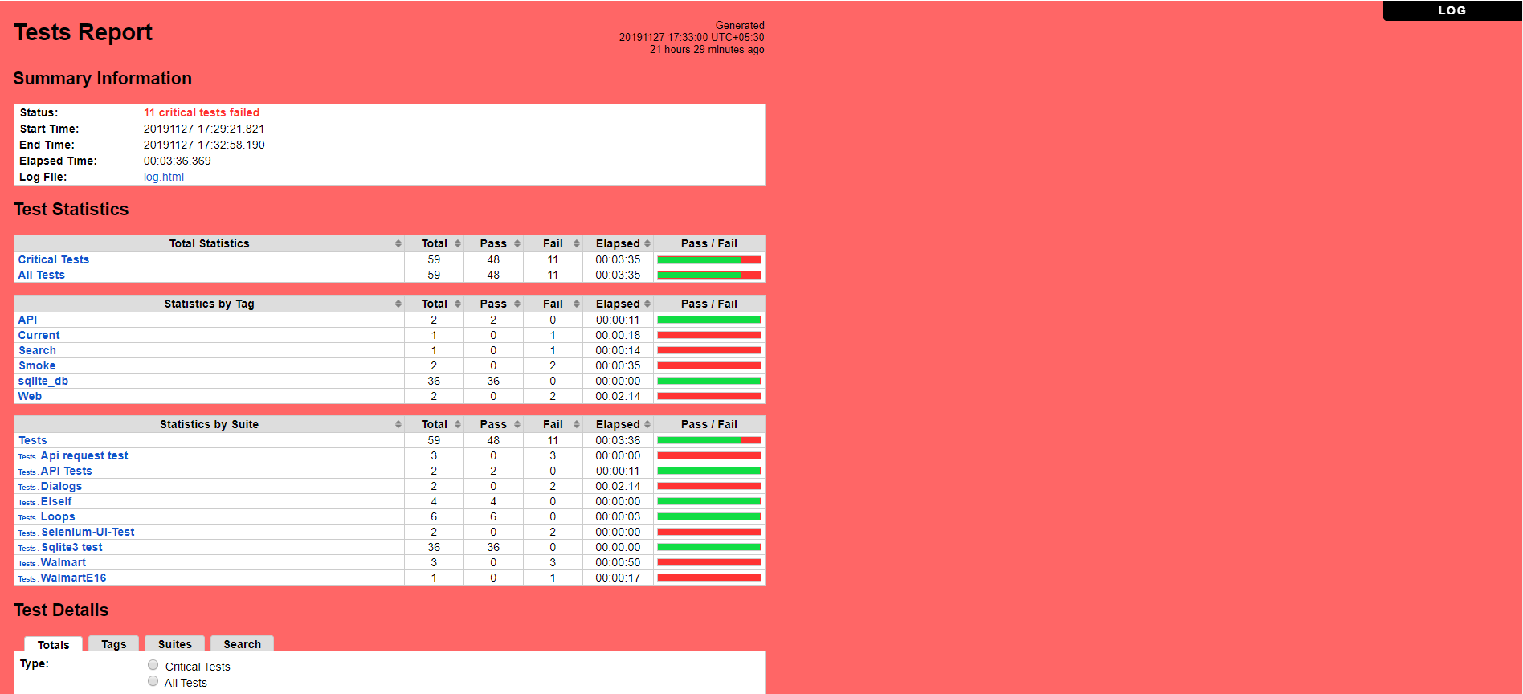
Test Report(in case of fail test cases)

Slide 15
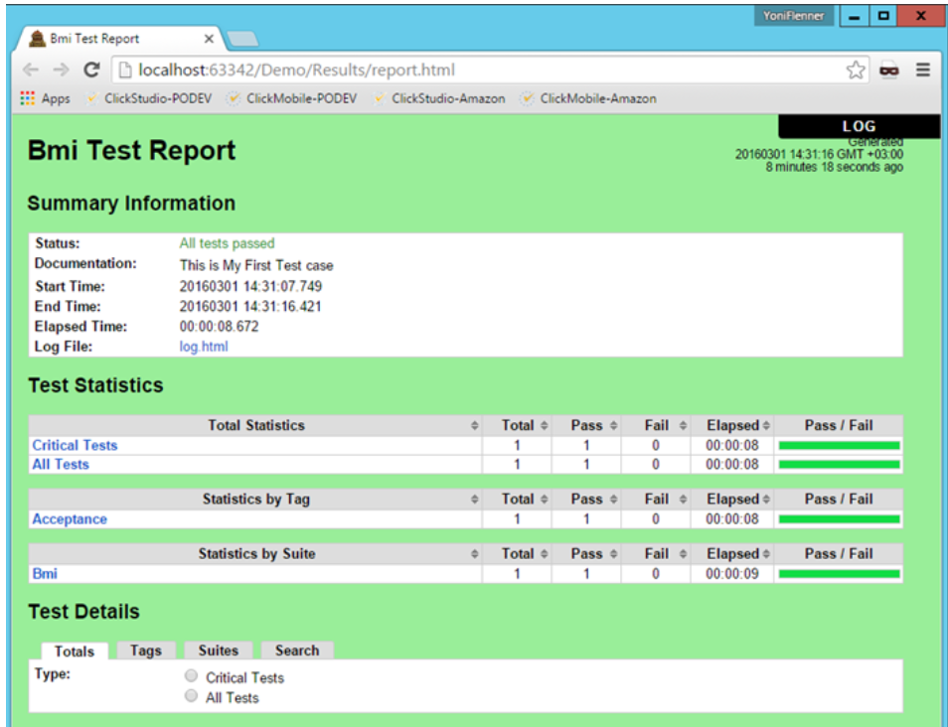
Test Report(in case of all test passed)

Slide 16
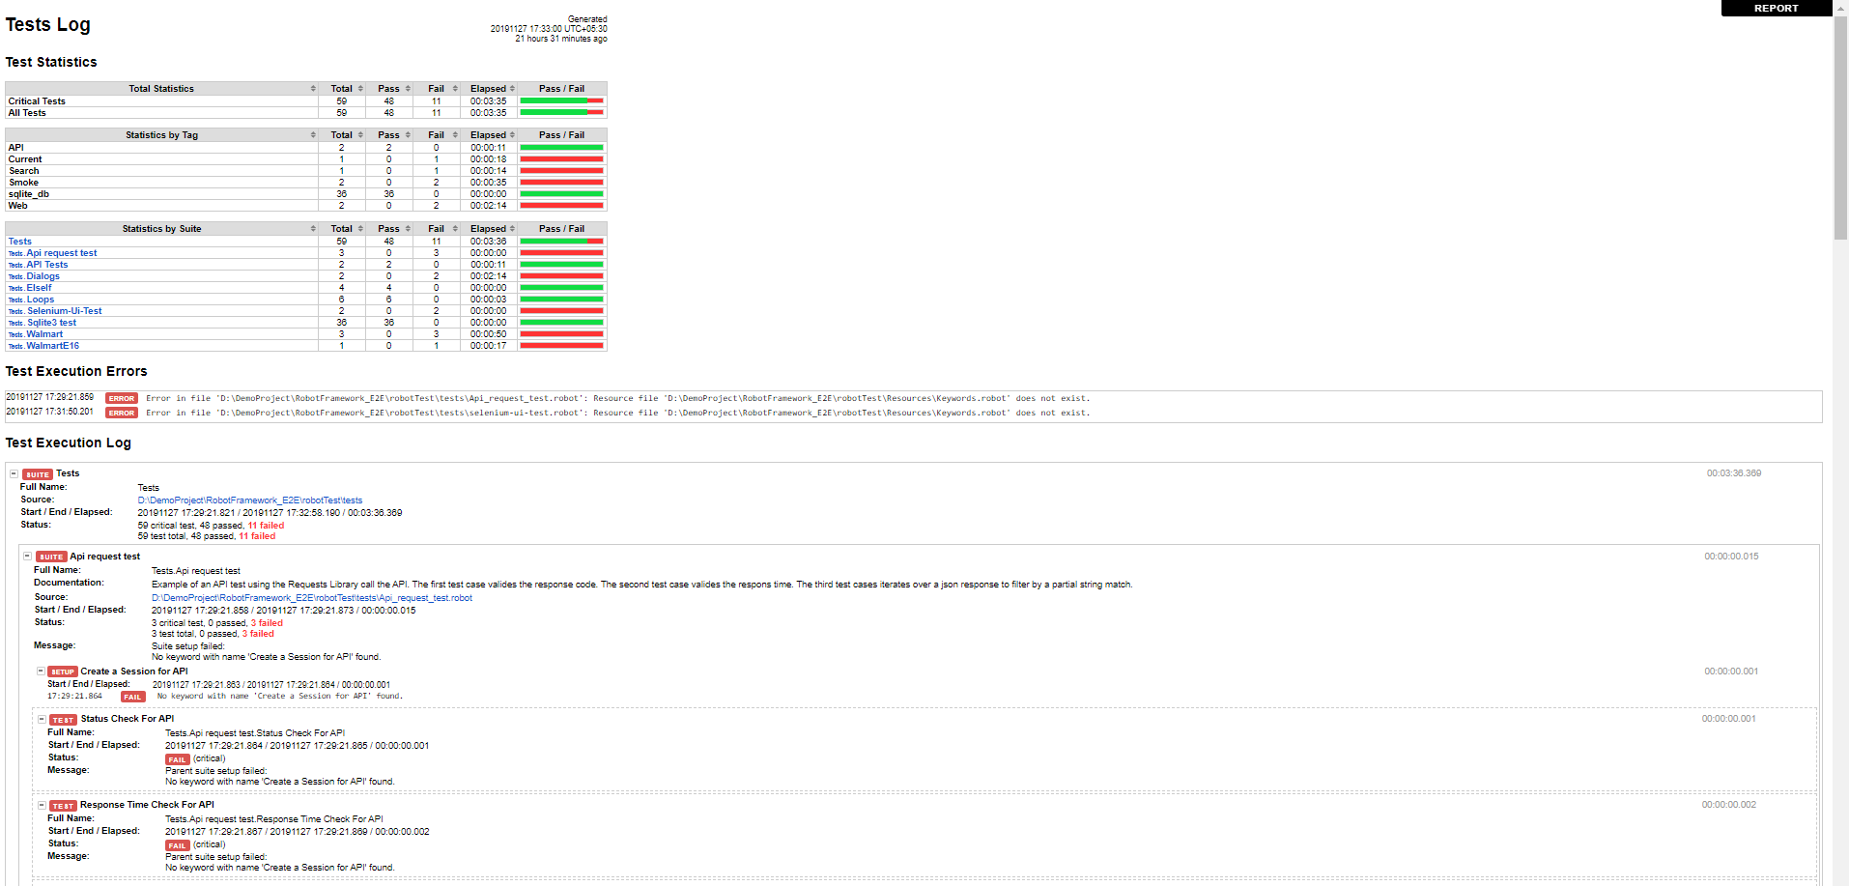
Test Log

Slide 17
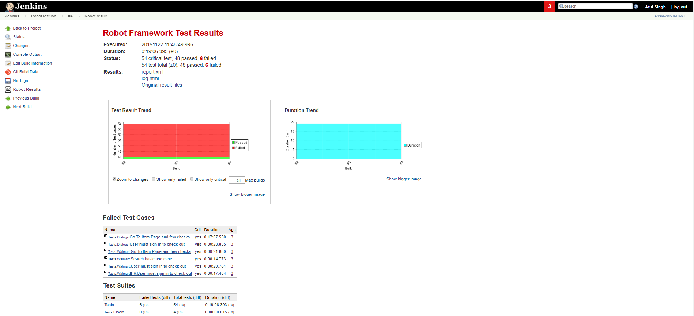
Jenkins Job Execution

Slide 18
For more information
Ecosystem front page https://robotframework.org/#/
Project pages https://github.com/robotframework/robotframework
QuickStart Guide https://github.com/robotframework/QuickStartGuide/blob/master/QuickStart.rst
User Guide http://robotframework.org/robotframework/#user-guide
Demo projects https://robotframework.org/#/documentation

Slide 19
DEMO

Slide 20
Thank You

